Slide 1
Big Data Analysis for Football Team Formation
Nexus Group
Henry Jones Inbaraj - C0863081
Meenakshi - C0864515
Javier A. Melo – C0871987
Amal Vandananikkal - C0863255
Kelvin Simon - C0866577

Slide 2
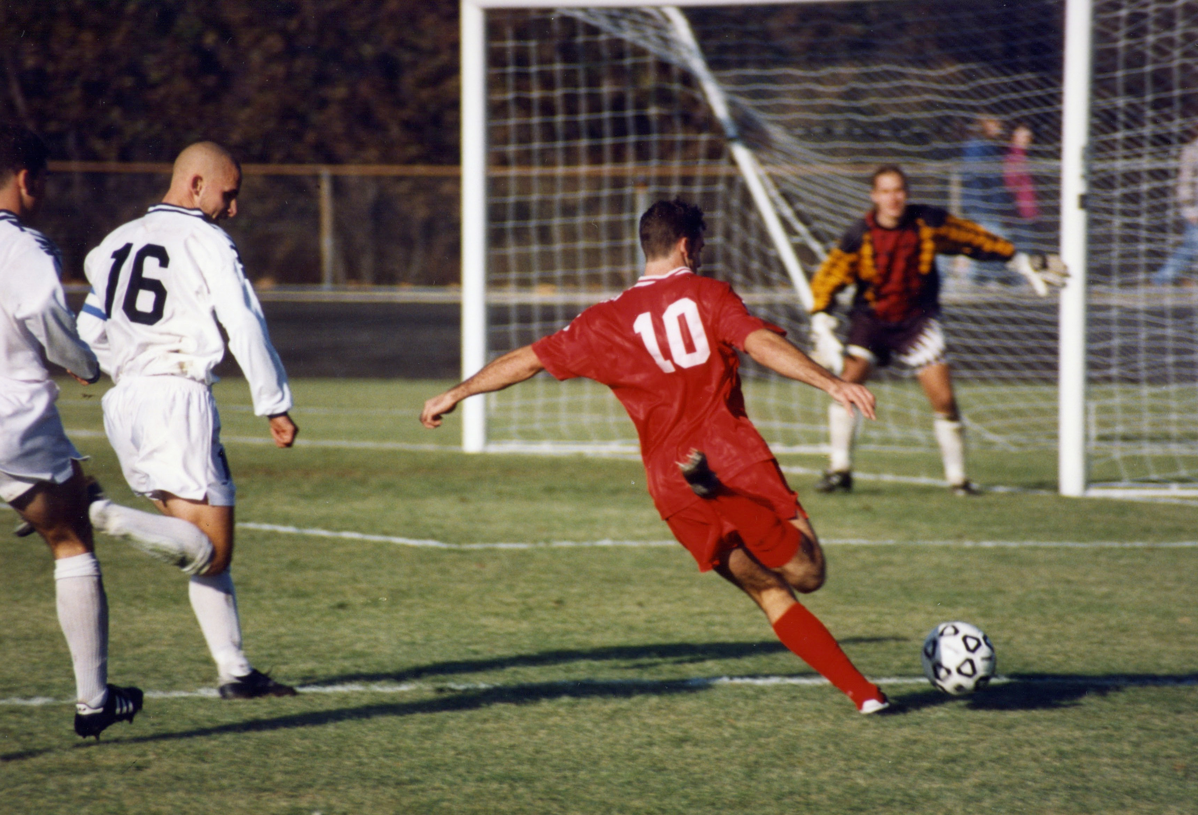
Going to make revolution in Football Industry !!
Are you ready ??!!!!
Lets start !!
Notes:
Image source: https://upload.wikimedia.org/wikipedia/commons/a/ad/Football_in_Bloomington%2C_Indiana%2C_1996.jpg

Slide 3
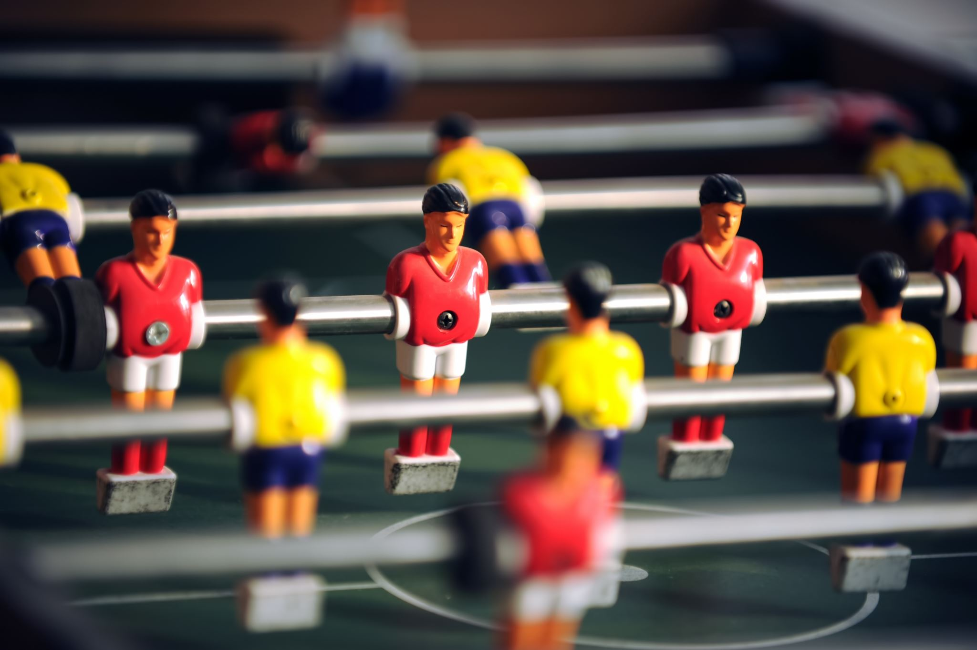
Introduction
The objective of this project is to analyze football player performance data to identify the top players for each position based on their performance metrics and data.
The project aims to assemble the most effective squad by using the findings of the analysis and to plan the game strategy.

Slide 4

Problem Statement
Finding the best player out of large data set.
1
Finding the best feature to rank the players.
2
Categorizing the data based on the player position.
3
Finding the best model to populate good results.
4
Evaluating the model to set the benchmark.
5

Slide 5
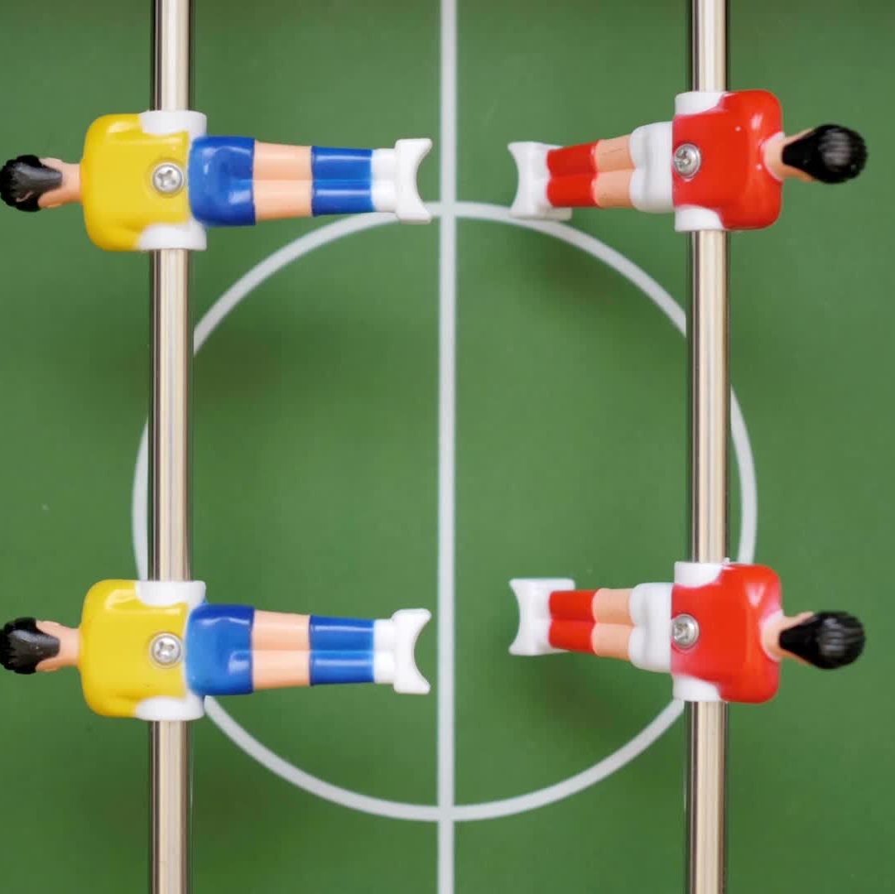
Goals
To find the most pertinent metrics to use in the analysis, the project team will explore their knowledge in both big data analysis and football.
Best Team formation out of best players
Predicting player’s position and player’s rating

Slide 6

Stages
Data Extraction
Data Exploring
Data Modeling
Outcome

Slide 7

Data Extraction
Data has been extracted from the single source (Kaggle)
It was a large dataset contains the data from past years.
Sample dataset has been extracted from the whole data.
Analyzing the data for the year 2022.

Slide 8
Data Exploring
Data loaded in to the pandas data frame.
Replacing null values.
Data skewness.
Statistical values.
Data frames created for each position to find the best features affecting the overall rating.
Correlation between the features.

Slide 9
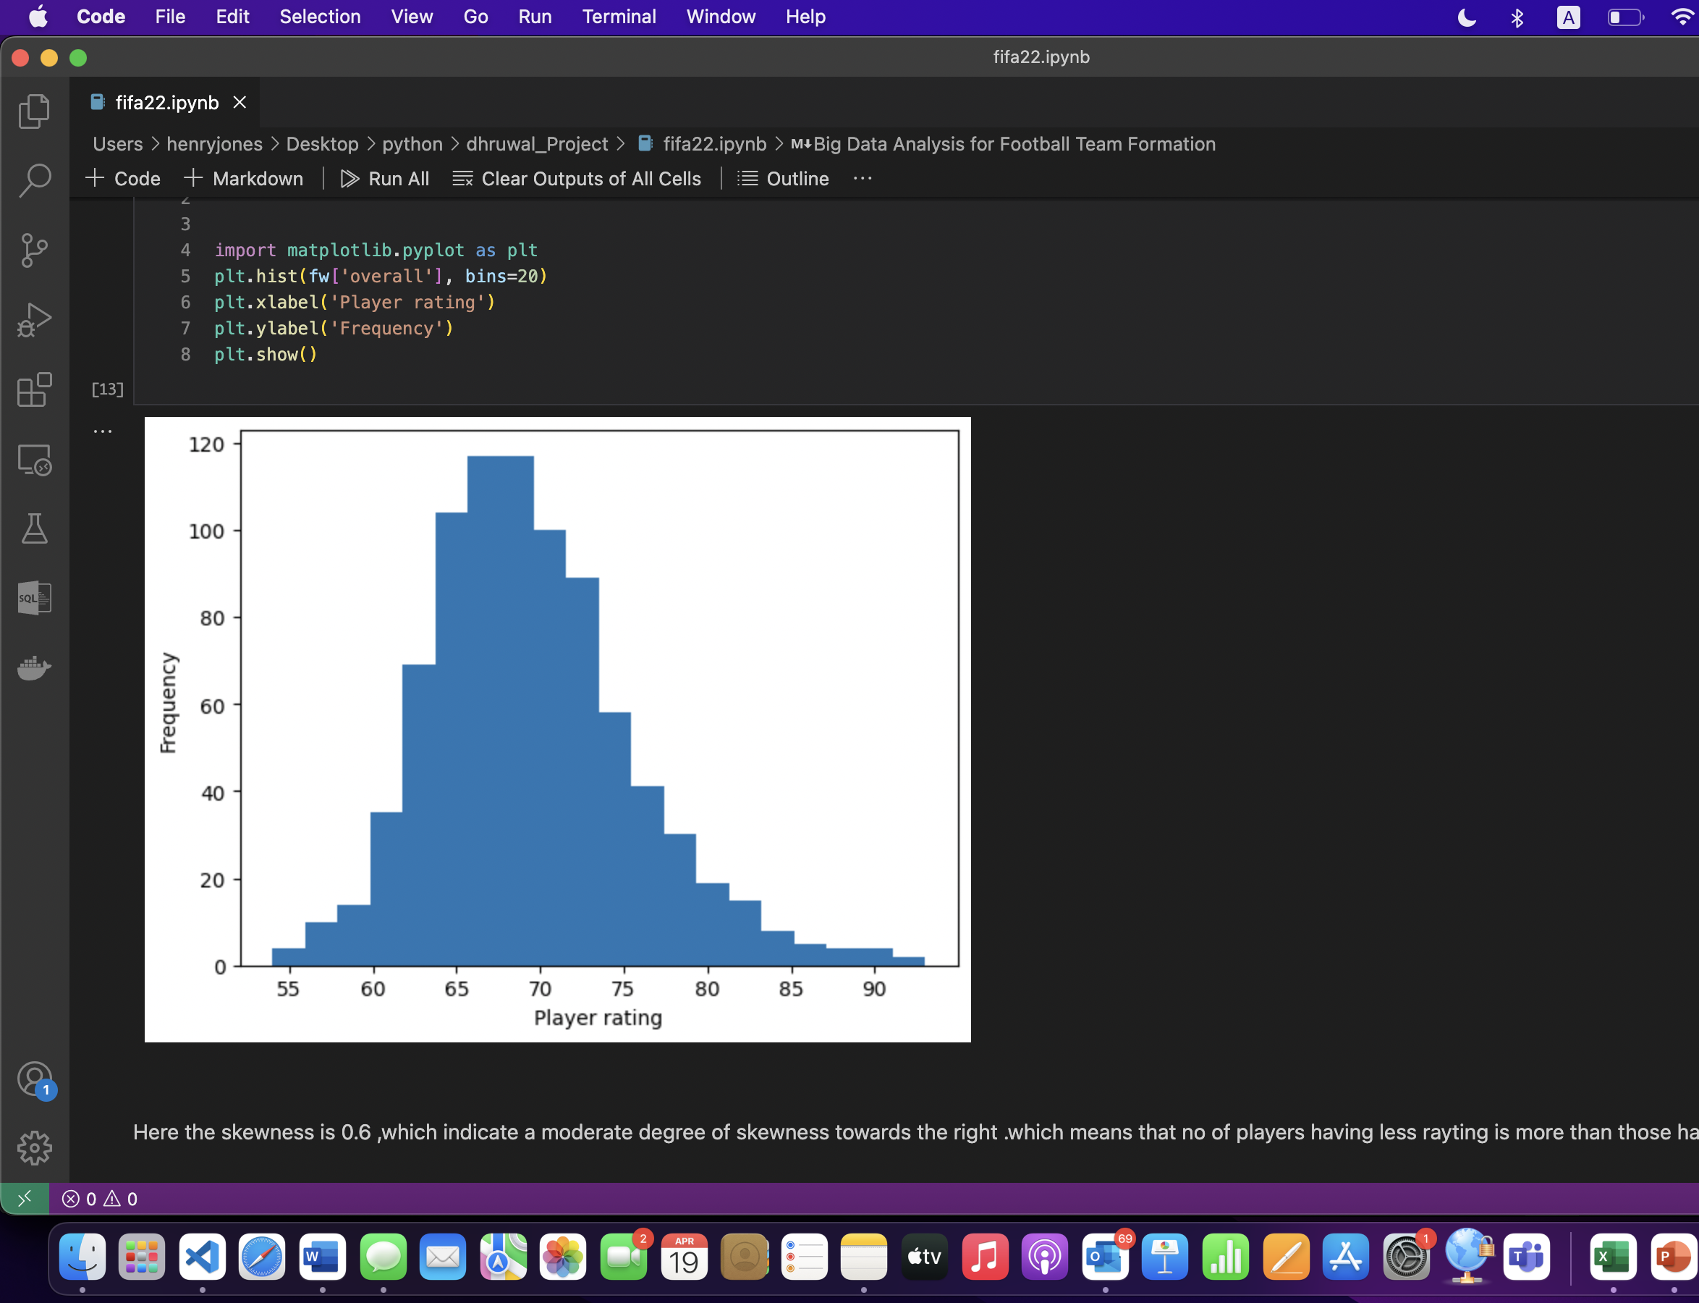
Data Skewness
Data skewness is 0.6 which indicates moderste degree of skewness towards the right
No of payers having higher rating is more than the less rating.

Slide 10

Statistical Values
Mean of the ‘overall rating’ is 69.38
Median of the ‘overall rating’ is 67.43
Mode of the ‘overall rating’ is 68
Maximum value of the ‘overall rating’ is 93
Minimum value of the ‘overall rating’ is 54
Standard deviation of the overall rating is 6.27

Slide 11
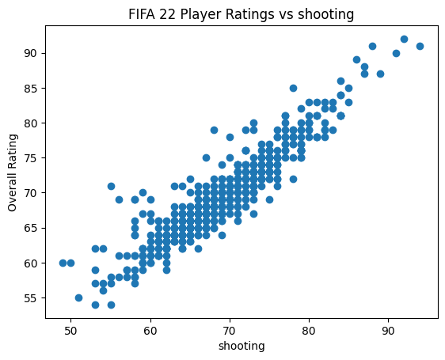
Correlation between the features

Slide 12
Best features for each position
Defense Position:
movement_reactions
defending
defending_standing_tackle
mentality_interceptions
defending_sliding_tackle
defending_marking_awareness
mentality_composure
attacking_short_passing
potential
skill_ball_control
skill_long_passing
passing
mentality_aggression
attacking_heading_accuracy

Slide 13
Best features for each position
Forward Position:
Shooting,
mentality_positioning,
movement_reactions,
skill_ball_control,
attacking_finishing,
dribbling, mentality_composure,
power_shot_power, potential,
attacking_short_passing,
skill_dribbling, power_long_shots,
attacking_volleys, passing,
mentality_vision,
mentality_penalties,
skill_curve,
skill_long_passing,
skill_moves

Slide 14
Best features for each position
Midfielder Position:
Skill ball_control
movement_reactions
attacking_short_passing
passing
dribbling
mentality_composure ,potential
skill_dribbling , mentality_vision
skill_long_passing , shooting
power_shot_power
mentality_positioning
power_long_shots
attacking_crossing
skill_curve
attacking_finishing

Slide 15
Best features for each position
Goal keeper:
goalkeeping_reflexes
goalkeeping_diving
goalkeeping_positioning
goalkeeping_handling
movement_reactions
potential
goalkeeping_kicking
power_shot_power

Slide 16
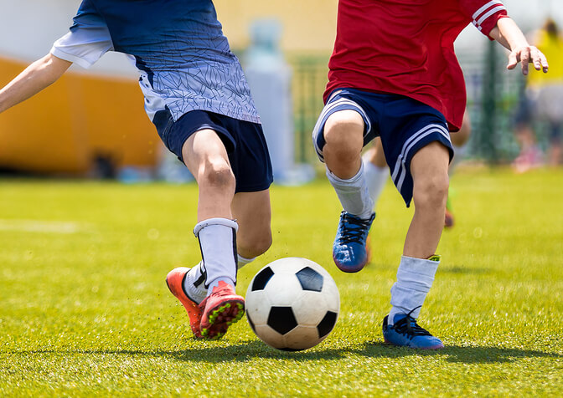
Best player for each Position
Notes:
Image source: https://thephysiocompany.co.uk/wp-content/uploads/football.jpg

Slide 17
Best player for each Position
Forward Position:
L Messi
Cristiano Ronaldo
R. Lewandowski
Mbappe,
H. Kane
Neymar Jr,
M. Salah,
H.Son,
S.Aguero
S.Mane

Slide 18
Best player for each Position
Defense Position:
Sergio Ramos,
Marquinhos,
V. van Dijk,
M. Hummels,
Rúben Dias,
A. Laporte,
D. Alaba,
Piqué,
L. Bonucci and
H. Maguire

Slide 19
Best player for each Position
Midfielder Position:
K. De Bruyne,
Bruno Fernandes,
T. Kroos,
P. Dybala,
Parejo,
P. Pogba,
L. Modrić,
M. Reus,
T. Müller and
İ. Gündoğan

Slide 20
Best player for each Position
GoalKeeper:
M. Neuer,
Ederson,
M. ter Stegen,
J. Oblak
Alisson,
G. Donnarumma,
M. Maignan,
T. Courtois,
K. Casteels
Y. Sommer

Slide 21
Data Modelling
KNN classifier – Player’s Position Prediction
KNN regressor – Player’s rating prediction
Linear regression – Player’s rating

Slide 22
Knn Model for predicting Position
Preprocessed data to train the KNN (K-Nearest Neighbors) model.
This algorithm works by finding the closest data points to a new observation and making a prediction based on the majority class of those neighbors.
This can help the team put the player in the correct position to maximize their potential and improve the team's overall performance.

Slide 23
Model for predicting rating
Two algorithm were used to predict the players rating
Linear regression model performed better with the accuracy of 98.96%, RMSE score of 0.299 and the error percentage is 1.04 %
KNN regressor model accuracy is 97.16% , RMSE score of 1.12 and error percentage is 2.84%.
Linear regression model performed better.

Slide 24
Outcome
Team formed with best players
Player’s position predicted
Player’s rating predicted

Slide 25
Best Team
S.No | Players | Positions
1. | L Messi | Forward position
2. | R. Lewandowski | Forward position
3. | Cristiano Ronaldo | Forward position
4. | Sergio Ramos | Defence Position
5. | Marquinhos | Defence Position
6. | V. van Dijk | Defence Position
7. | P. Dybala | Mid Fielder
8. | T. Kroos | Mid Fielder
9. | K. De Bruyne | Mid Fielder
10. | Bruno Fernandes | Mid Fielder
11. | M. Neuer | Goal Keeper

Slide 26
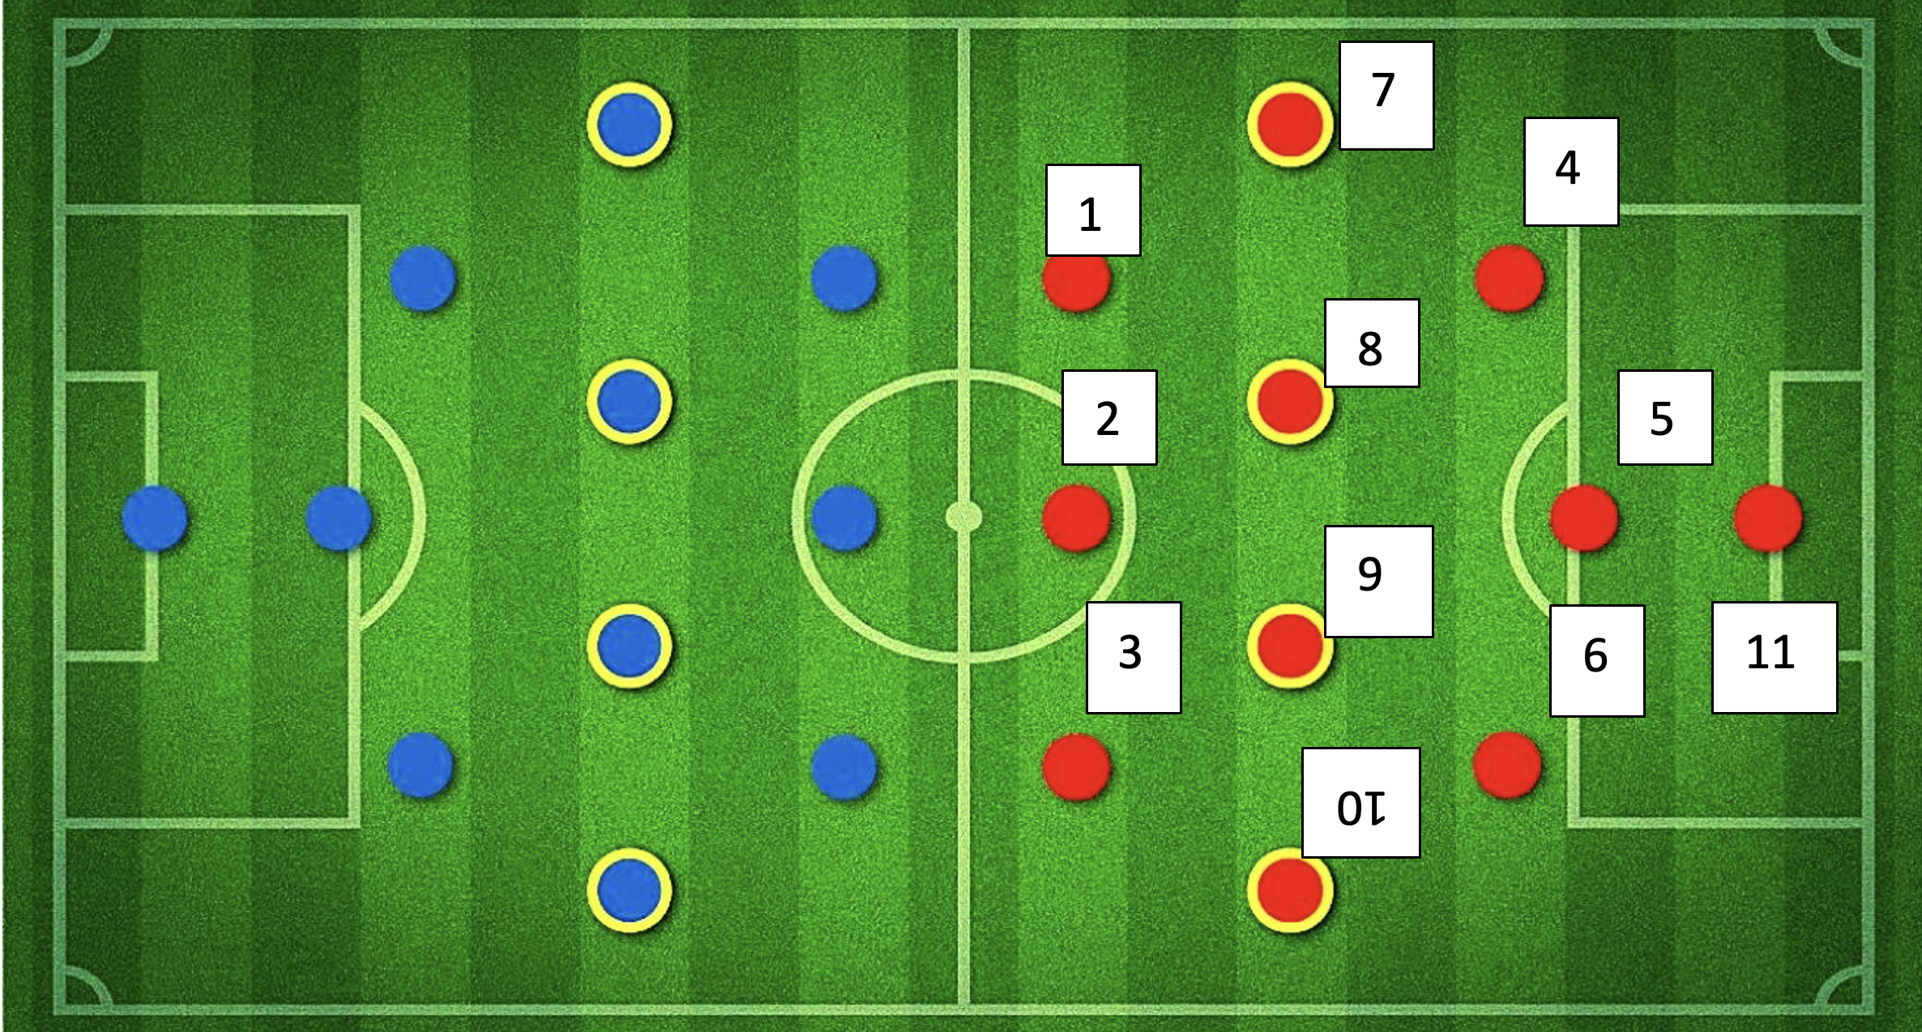
Best Team
Notes:
Image source: https://prod.chaseyoursport.com/blogImage/0.23817092486590896.jpeg

Slide 27
Limitations
Data quality might affect. Good quality with more data can give better results.
Resources limitations
Features in data

Slide 28

Advantages
The Big Data Analysis for Football Team Formation project will revolutionize the football industry by providing data-driven insights.
The insights generated from this project can help improve team performance and identify new talents.
The project can help teams recruit players more efficiently and effectively by using objective data to inform their decisions.
The use of data-driven insights can also enhance fan engagement by improving the quality of the game.

Slide 29
Advantages
If every team in the football leagues uses this project, it will benefit both the league and clubs by improving overall performance and reducing recruitment mistakes.
The project can help teams identify top-performing players for each position, leading to more efficient and effective team formations.
By using objective data analysis, teams can gain a competitive advantage over other teams that do not use such analysis.

Slide 30
Advantages
The project has the potential to transform the football industry by ushering in a new era of data-driven decision-making.
The insights generated from this project can be used to develop new strategies and tactics that can help teams win more games and championships.
The project can help reduce the risk of making costly recruitment mistakes by providing comprehensive data analysis on potential players.

Slide 31
Future implementation
This project implementation process can be followed for other sports to increase the game quality.
For example, these ideas can be implemented in the Hockey game as it is not popular and not having a great number of viewers.
This will enhance and boost the game in a positive trend.

Slide 32
Conclusion
Our project found the best players and recommended the best team out of it.
We have two models to predict the player’s position to plan the game strategy and to find the player’s rating to elevate the game standard.
This will definitely bring a humongous change in the industry to make the game interesting, which will increase the game popularity, views, and sponsorship.
We have planned to implement this project to other games as well to benefit the industry more.

Slide 33
References
https://scikit-learn.org/stable/modules/generated/sklearn.neighbors.KNeighborsRegressor.html
https://scikit-learn.org/stable/modules/generated/sklearn.neighbors.KNeighborsClassifier.html
https://scikit-learn.org/stable/modules/generated/sklearn.linear_model.LinearRegression.html
https://moodle.queenscollege.ca/moodle/pluginfile.php/1625917/mod_resource/content/7/Week5_Modified.pdf
https://moodle.queenscollege.ca/moodle/pluginfile.php/1625908/mod_resource/content/5/Week2_Modified.pdf
https://moodle.queenscollege.ca/moodle/pluginfile.php/1625905/mod_resource/content/1/Week1%20notes%20.pdf
https://moodle.queenscollege.ca/moodle/pluginfile.php/1625926/mod_resource/content/9/Week7_Modified.pdf
https://www.kaggle.com/datasets/stefanoleone992/fifa-22-complete-player-dataset?select=players_22.csv

